Slide 1
MCSD51: Certificate in Introductory Software Development Level 5
Part 2:
Product Implementation

Slide 2
Password Generator
Maribeth Estimos
Xian (Richard) Zhang
Zhengwen (Steven) Lei

Slide 3
Agenda
1. What is a Password Generator
2. Why we chose this project
3. Technologies
4. Methodology
5. Team work
6. Reflections
7. References
8. Demo
9. Q & A

Slide 4
What is A Password Generator?
Create a random password for use when registering or changing passwords in websites and apps
Platforms:
Computers/Laptops (Mac & Windows), phones (IOS & Android), tablets (ipads & other brands)

Slide 5
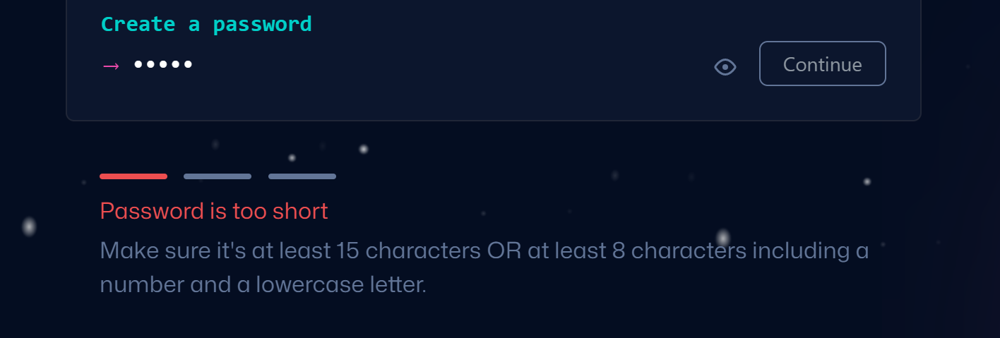
Why we chose this project?
Hard to create a complex password

Slide 6
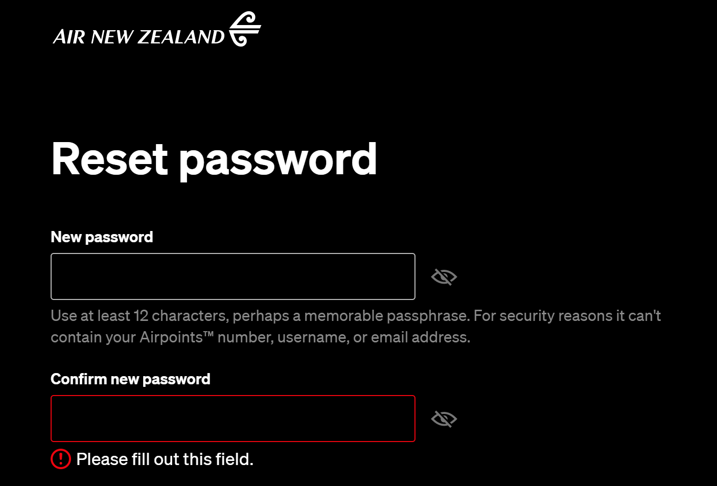
Why we chose this project?
Hard to create a complex password

Slide 7
Why we chose this project?
Users often create simple passwords like these;
123456,1234567890
qwert, qweryuiop
123456qwerty, 1qaz2wsx

Slide 8
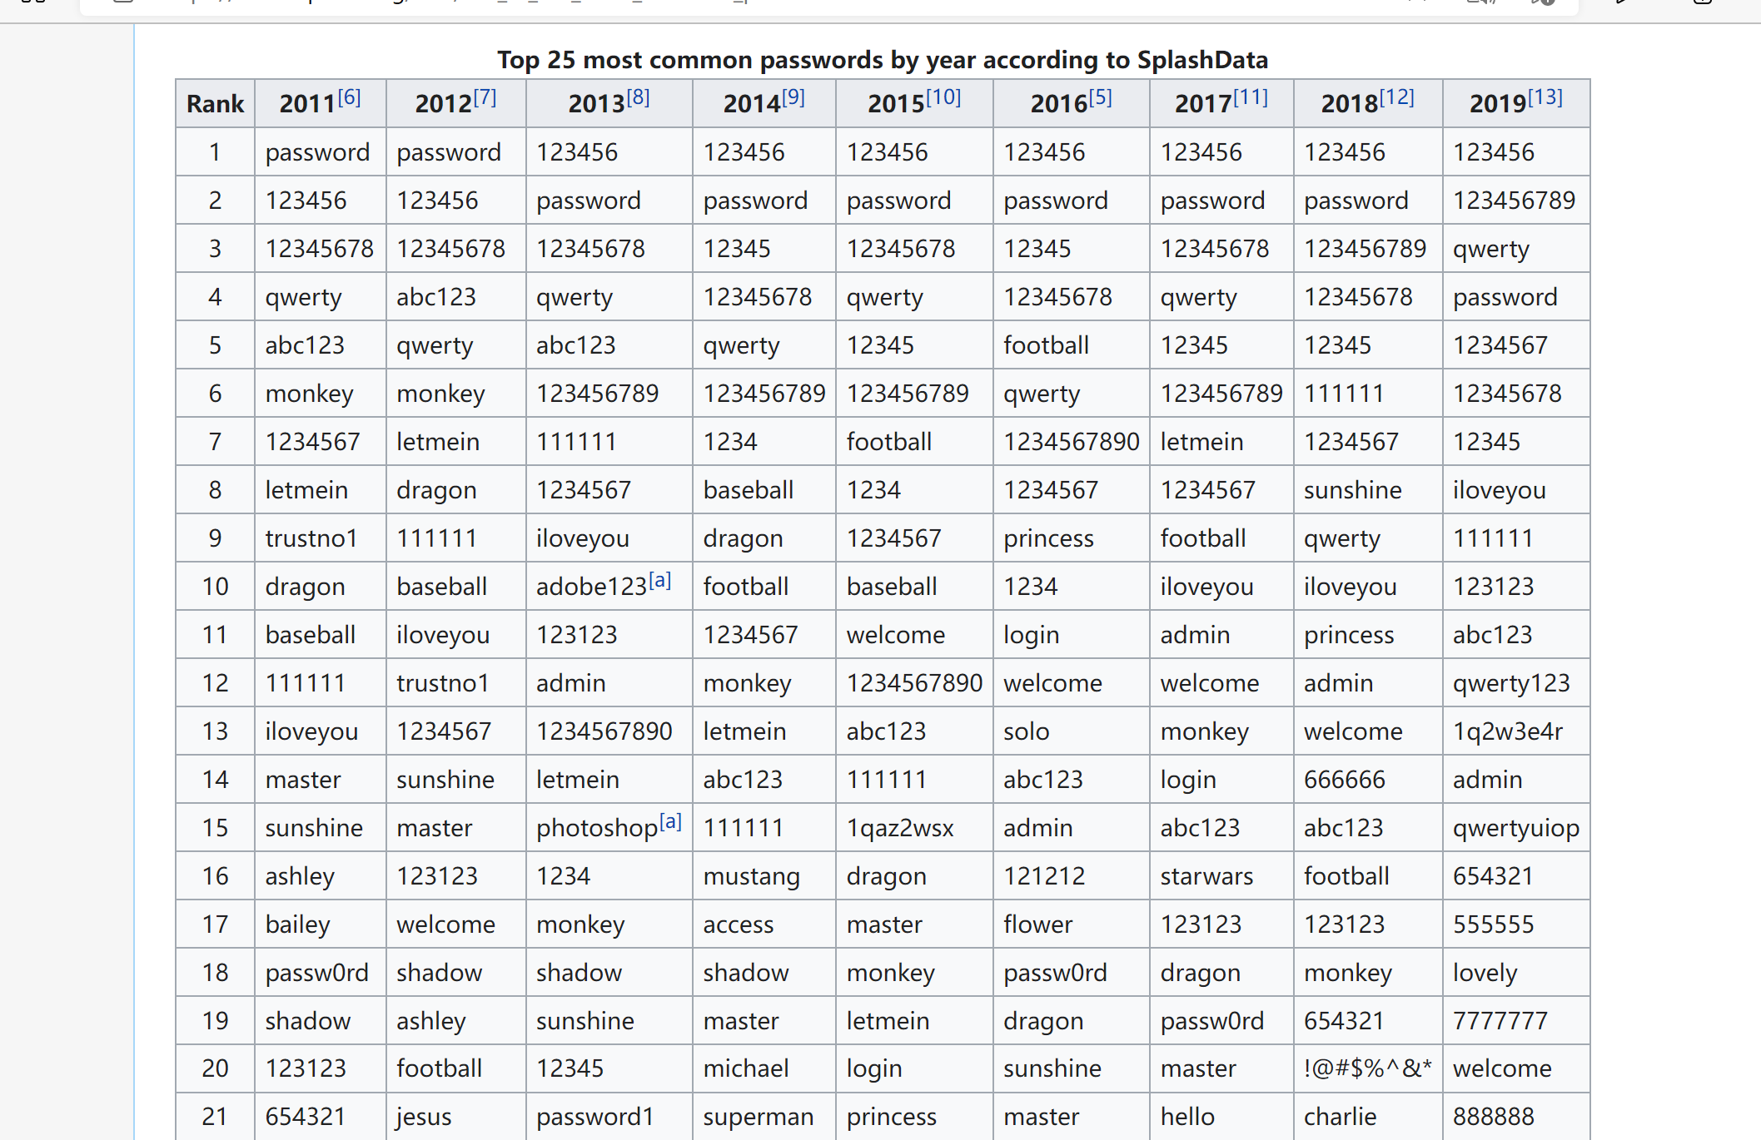
Retrieved from: List of the most common passwords - Wikipedia

Slide 9
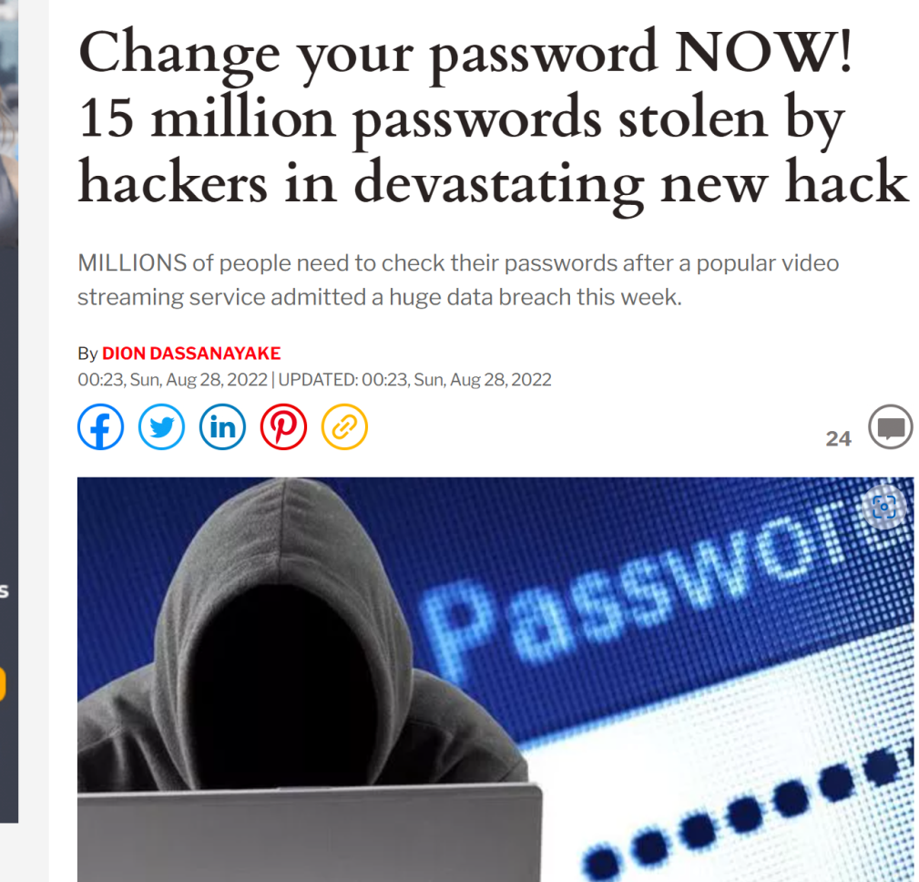
Risks of password leaking
1. Private information exposure
2. Money loss
3. Risks of ID frauds
Retrieved from: Change your password NOW! 15 million Plex passwords stolen by hackers | Express.co.uk

Slide 10
Technologies Used
Web-based software
Tools: Apache, Nodejs
Modules: express, ejs, cookie-parser
Languages: Javascript, Javascript( embedded ), HTML, CSS
Request method: POST / GET

Slide 11
methodology
4 reasons for using waterfall methodology
The requirements are clear.
Relatively simple system.
Only used in certain circumstances
Unlikely to be changed.
1. Allow input of various input parameters on password such as Password Length, Include Special Characters, Numbers, Lower/Upper case Characters
2. Save the settings for future use
3. Generate a random password based on the above parameters
4. Copy function to copy the generated password to the buffer (like Control + C)
Retrieved from: Project list

Slide 12
TEAM WORK
Client (Richard)
User Interface (HTML/ejs, CSS, embedded javascript)
Server (Steven)
request process (javascript)
Cookies process (javascript)
Server( Maribeth)
implement a module for Password Generator (javascript)

Slide 13
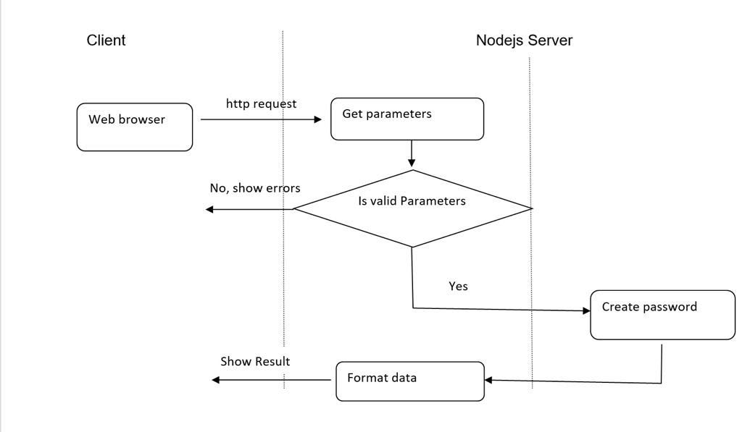
TEAM WORK

Slide 14
Reflections
Maribeth:
Richard:
Steven:

Slide 15
References

Slide 16
Q&A
Answer Questions

